Slide 1



Database Management System(303105203)
Computer Science & Engineering
Shubham Upadhyay

Slide 2


UNIT-7
Introduction

Slide 3
Introduction:
Query Processing
Layers of Query Processing
Measures of Query Cost
File Scan(Linear & Binary Search)
Materialized View & Pipelining.
Query Optimization
Equivalence Rules
Cost-Based Query Optimization

Slide 4
What is relational Model?
What Query Processing ?
Query processing is a translation of high-level queries into low-level expression.
It is a step wise process that can be used at physical level of the file system, query optimization and actual execution of query to get the result.
Its refers to the range of activities that are involved in extracting data from the database.

Slide 5
Need for Querying Processing:
1. Interpreting the Query: Understanding and converting the query from a high-level language (like SQL) into a format that the database can process.
2. Searching Through Data: Accessing and retrieving the relevant data from the database storage that satisfies the query conditions.
Note: Overall, query processing involves transforming a user's request into actions that efficiently retrieve the desired information from a database.

Slide 6
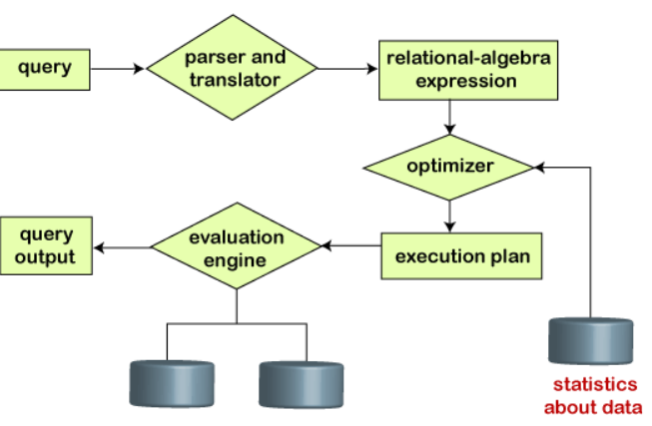
Step in Query Processing:
Parsing and translation
Optimization
Evaluation

Slide 7
Process of SQL
Parsing: The parser takes the SQL query as input and checks it for syntax and semantic correctness.
Components:
Lexical Analyzer: Breaks the query into tokens.
Syntax Analyzer: Verifies the query structure.
Semantic Analyzer: Checks the validity of the query against the database schema (e.g., table names, column names).

Slide 8
Optimization:
Query optimization is a crucial phase in query processing where the database management system (DBMS) seeks to determine the most efficient way to execute a given query.
This process involves generating, evaluating, and selecting the best possible execution plan from many alternatives.

Slide 9
Advantages of SQL
Key Objectives of Query Optimization:
Minimize Response Time: Reduce the time it takes to return the query results.
Minimize Resource Utilization: Efficiently use system resources like CPU, memory, and disk I/O.
Ensure Scalability: Maintain performance as the size of the database and the number of queries increase.

Slide 10
Evaluation: Finally runs the query and display the required result.
Layers of Query Processing:
1. Query Decomposition
2. Data Localization
3. Global Query Optimization
4. Distribution Query Execution

Slide 11
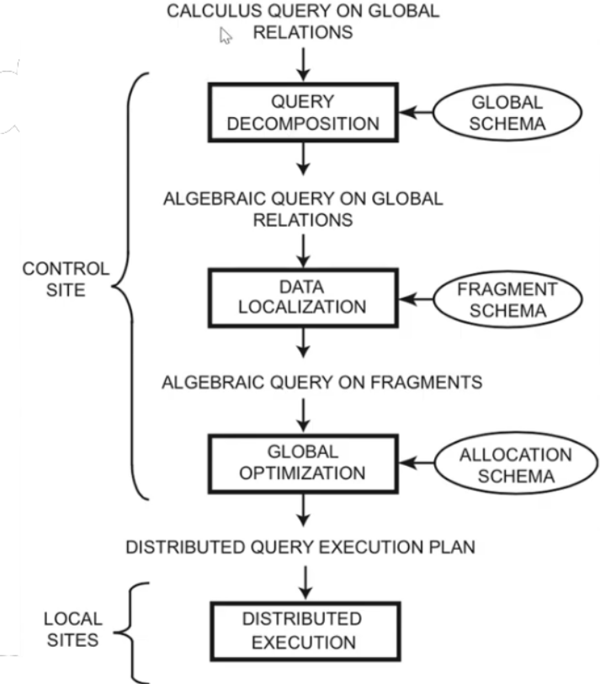


Slide 12
Query Decomposition: The first layer decomposes the calculus query into an algebraic query on global relations. The information needed for this transformation is found in the global conceptual schema describing the global relations.
Query decomposition can be viewed as four successive steps.
i) Normalization
ii) Analysis
iii) Simplification
iv) Restructure

Slide 13
First, the calculus query is rewritten in a normalized form that is suitable for subsequent manipulation. Normalization of a query generally involves the manipulation of the query quantifiers and of the query qualification by applying logical operator priority.
Second, the normalized query is analyzed semantically so that incorrect queries are detected and rejected as early as possible. Techniques to detect incorrect queries exist only for a subset of relational calculus.

Slide 14
Third, the correct query is simplified. One way to simplify a query is to eliminate redundant predicates. Note that redundant queries are likely to arise when a query is the result of system transformations applied to the user query. such transformations are used for performing semantic data control (views, protection, and semantic integrity control).
Fourth, the calculus query is restructured as an algebraic query. The traditional way to do this transformation toward a "“better" algebraic specification is to start with an initial algebraic query and transform it in order to find a go.

Slide 15
2. Data Localization: The input to the second layer is an algebraic query on global relations. The main role of the second layer is to localize the query's data using data distribution information in the fragment schema.
This layer determines which fragments are involved in the query and transforms the distributed query into a query on fragments.
Generating a query on fragments is done in two steps:
First, the query is mapped into a fragment query by substituting each relation by its reconstruction program (also called materialization program).
Second, the fragment query is simplified and restructured to produce another "good" query.

Slide 16
3. Global Query Optimization: The input to the third layer is an algebraic query on fragments. The goal of query optimization is to find an execution strategy for the query which is close to optimal.
Query optimization consists of finding the "best" ordering of operators in the query, including communication operators that minimize a cost function.

Slide 17
4.Distribution Query Execution: The last layer is performed by all the sites having fragments involved in the query.
Each sub query executing atone site, called a local query, is then optimized using the local schema of the site and executed.

Slide 18
Measures of Query Cost
Query Cost is a cost in which the enhancer considers what amount of time your query will require.
It involves query processing time i.e.; time taken to parse and translate the query, optimize it, evaluate, execute and return the result to the user is called cost of the query.

Slide 19
The key factors influencing query cost include:
1.CPU Time: The amount of processor time needed to execute the query
2.I/O Operations: The number of input/output operations required to retrieve data from storage.
3. Memory Usage: The amount of RAM used during query execution.
4. Network Latency: Time taken to transfer data across the network, particularly in distributed systems.
5. Disk Access: Time required to read or write data to disk.

Slide 20
The cost of query evaluation can be measured in terms of:
i)The number of disk accesses.
ii)Time of Execution taken by the CPU to execute a query.
iii)The involved Communication costs in either distributed or parallel database systems.

Slide 21
For simplicity we just use the number of block transfers from disk and the number of seeks as the cost measures
t_{T} – time to transfer one block
t_{S} – time for one seek
Cost for b block transfer plus S seeks
b * t_{T} + S * t_{S}

Slide 22
File Scans
File scans refer to the methods used to locate and retrieve records from a database file. When a query is executed, the DBMS may need to scan the file to find the relevant records.
The efficiency of these scans can significantly impact query performance.
There are two scan algorithms to implement:
Linear Search
Binary search

Slide 23
1.Linear Search: Linear search, also known as sequential search, is a fundamental algorithm used in database management systems (DBMS) to find a specific record within a database file.
It operates by checking each record in sequence until the desired record is found or the end of the file is reached.

Slide 24
Steps of Linear Search in a DBMS:
1.Start at the Beginning: The search process begins with the first record in the database file.
2.Check Each Record: Each record is examined one by one to see if it matches the search criteria (e.g., a specific ID, name, or other attributes).
3.Compare the Record: The search key (the value you are looking for) is compared with the corresponding attribute in the current record.
4.Continue Sequentially: If the current record does not match the search key, the search moves to the next record in the sequence.
5.Repeat Until Found or End: This process is repeated until either:
->The desired record is found (a match is found).
->The end of the file is reached without finding a match.

Slide 25
6.Return Result: If a match is found, the record is returned.
->If no match is found after scanning all records, the search concludes that the record does not exist in the file.
Suppose t_{S} is the seek time (number of Seek is usually one – to reach the beginning of the file) , t_{T} is the number of traversal time for one block, and B is the number of blocks to be transferred, then the cost is calculated as:
tS + (B*tT) =>This is the cost required to fetch the record based on non-key attribute.

Slide 26
Suppose the search is based on the key value. Then the average cost of query is tS + (B*tT)/2 and at worst case it would be tS + (B*tT).
2. Binary search: Binary search is a more efficient search method that requires the data to be sorted. It works by repeatedly dividing the search interval in half.
Preconditions for Binary Search:
1. Sorted Data: The data must be sorted based on the search key. Binary search is only applicable to ordered datasets.

Slide 27
2. Access Method: The DBMS must be able to quickly access the middle element of the current search interval, which is usually facilitated by indexing or direct access methods.
Steps of Binary Search in a DBMS:
1. Initialize Search Interval:Start with the entire dataset as the initial search interval. This means you consider the first record to the last record.

Slide 28
2. Find Middle Record: Calculate the middle index of the current search interval.
3. Compare and Narrow Down: Compare the search key with the key of the middle record.
If the search key matches the middle record's key, the search is successful, and the record is returned.
If the search key is less than the middle record's key, narrow the search interval to the left half (all records before the middle record).

Slide 29
If the search key is greater than the middle record's key, narrow the search interval to the right half (all records after the middle record).
4. Repeat: Continue dividing the interval and comparing until the search key is found or the interval is empty.
5. Return Result: If the search key is found, return the corresponding record.
->If the search interval becomes empty (no more records to check), conclude that the record is not present in the dataset.

Slide 30
Suppose blocks of records are stored continuously in the memory and the cost of the query to fetch first record is calculated as log (B)* (ts+ tT).
Formula Components
->B: Number of blocks.
->log(B): Logarithmic function indicating how many levels or steps are needed to reach the desired block.
->ts​: Time to seek to the correct block in memory (seek time).
->tT​: Time to transfer the data from the block to the CPU (transfer time).

Slide 31
Materialized View
A materialized view in a database management system (DBMS) is a database object that contains the results of a query.
Unlike a regular view, which is a virtual table computed dynamically upon access, a materialized view stores the query result physically on disk.
This allows for quicker access to complex query results, as the data is pre computed and stored, but it also requires management to keep the data up to date.

Slide 32
NOTE:
Materialized views are a powerful tool in DBMS for improving query performance, especially for complex and frequently executed queries.
Properly managing refresh strategies is crucial to ensure the data in materialized views remains accurate and up to date.

Slide 33
Pipelining
Pipelining in the query treatment means the method is based on the approach of splitting the query processor into multiple mini-processes, which help to perform parallel tasks and, as a result, increase the efficiency of the queries.
Pipelining is a technique where multiple instructions are overlapped during execution.
Pipelining techniques are crucial for improving query performance and resource utilization in modern database management systems.

Slide 34
How pipelining works in the context of DMS:
1.Parallel Execution: Different stages of a query can be processed in parallel.
2. Reduced I/O Wait Times: By overlapping operations, pipelining can reduce the time spent waiting for disk I/O operations.
3.Improved Resource Utilization: Pipelining can make better use of CPU, memory, and disk resources by keeping all parts of the system busy.

Slide 35
4.Examples in SQL Queries: In an SQL query, pipelining might be used when combining multiple operations such as joins, selections, and projections. For instance, if a query involves joining two tables and then filtering the results, pipelining allows the filtering to start as soon as the first rows of the join are produced.
5.Pipeline Execution Plans: Modern database systems often create execution plans that take advantage of pipelining. These plans specify the order of operations and how data flows between them to maximize efficiency.

Slide 36
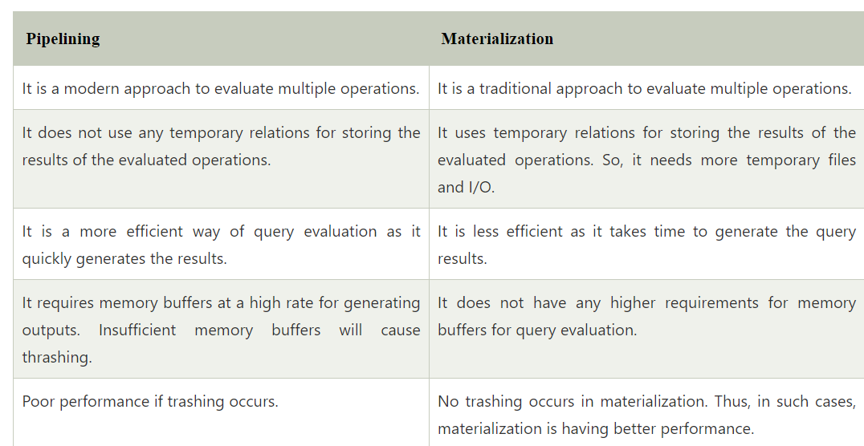

Slide 37
Query Optimization
Query optimization in a Database Management System (DBMS) is the process of improving the execution efficiency of a query.
The goal is to find the most efficient way to execute a given query by considering various possible query execution plans and selecting the one with the lowest estimated cost.

Slide 38
Key Concepts:
1.Query Execution Plan (QEP): A QEP is a sequence of operations that the DBMS will perform to execute a SQL query. It includes choices like the order of table joins, the use of indexes, and the selection of specific algorithms for operations like sorting and filtering.
2.Cost Model: The optimizer uses a cost model to estimate the resource consumption (CPU, memory, I/O) of different query plans. The plan with the lowest estimated cost is chosen.

Slide 39
Equivalence Rules
Equivalence rules in a Database Management System (DBMS) are fundamental principles used during query optimization to transform queries into different but equivalent forms.
These transformations help the query optimizer generate alternative execution plans and choose the most efficient one.

Slide 40
Key Equivalence Rules:
1.Commutativity of Join:
->The order of joining tables can be switched without affecting the result.
->Rule: 𝑅⋈𝑆≡𝑆⋈𝑅R⋈S≡S⋈R
->Examples:
SELECT * FROM employee e JOIN department d ON e.dept_id = d.id;
is equivalent to:
SELECT * FROM department d JOIN employee e ON d.id = e.dept_id;

Slide 41
2. Associativity of Join:
->The grouping of joins can be changed without affecting the result.
->Rule: (𝑅⋈𝑆)⋈𝑇≡𝑅⋈(𝑆⋈𝑇)(R⋈S)⋈T≡R⋈(S⋈T)
->Example:
SELECT * FROM (employee e JOIN department d ON e.dept_id = d.id) JOIN location l ON d.location_id = l.id;
is equivalent to:
SELECT * FROM employee e JOIN (department d JOIN location l ON d.location_id = l.id) ON e.dept_id = d.id;

Slide 42
3. Selection Distribution over Join:
->A selection condition can be applied before or after a join.
->Rule: 𝜎𝜃(𝑅⋈𝑆)≡𝑅⋈𝜎𝜃(𝑆)σθ​(R⋈S)≡R⋈σθ​(S) if 𝜃θ only involves attributes of 𝑆S.
->Example:
SELECT * FROM employee e JOIN department d ON e.dept_id = d.id WHERE d.location = 'New York';
Is equivalent to:
SELECT * FROM employee e JOIN (SELECT * FROM department WHERE location = 'New York') d ON e.dept_id = d.id;

Slide 43
4. Projection Distribution over Join:
->Projection can be applied before or after a join.
->Rule: Π𝐴(𝑅⋈𝑆)≡Π𝐴(Π𝐵(𝑅)⋈Π𝐶(𝑆))ΠA​(R⋈S)≡ΠA​(ΠB​(R)⋈ΠC​(S)), where 𝐵⊆𝐴∪𝐾𝑅B⊆A∪KR​ and 𝐶⊆𝐴∪𝐾𝑆C⊆A∪KS​.
->Example:
SELECT e.name, d.name FROM employee e JOIN department d ON e.dept_id = d.id;
Is equivalent to:
SELECT e.name, d.name FROM (SELECT id, name FROM employee) e JOIN (SELECT id, name FROM department) d ON e.dept_id = d.id;

Slide 44
5. Selection Distribution over Union:
->Selection can be distributed over a union operation.
->Rule: 𝜎𝜃(𝑅∪𝑆)≡𝜎𝜃(𝑅)∪𝜎𝜃(𝑆)σθ​(R∪S)≡σθ​(R)∪σθ​(S)
->Example:
SELECT * FROM (SELECT * FROM employee WHERE dept_id = 10) UNION (SELECT * FROM employee WHERE dept_id = 20);
Is equivalent to:
SELECT * FROM employee WHERE dept_id = 10 UNION SELECT * FROM employee WHERE dept_id = 20;

Slide 45
6. Projection Distribution over Union:
->Projection can be distributed over a union operation.
->Rule: Π𝐴(𝑅∪𝑆)≡Π𝐴(𝑅)∪Π𝐴(𝑆)ΠA​(R∪S)≡ΠA​(R)∪ΠA​(S)
->Example:
SELECT name FROM (SELECT name, dept_id FROM employee WHERE dept_id = 10 UNION SELECT name, dept_id FROM employee WHERE dept_id = 20);
Is equivalent to:
SELECT name FROM employee WHERE dept_id = 10 UNION SELECT name FROM employee WHERE dept_id = 20;

Slide 46
Cost-Based Query Optimization
Cost-based query optimization is an overall process of choosing the most efficient means of executing a SQL statement based on overall cost of the query.
The efficient execution is the execution with minimum cost.
In this optimization technique, all of the possible ways or scenarios in which a query can be executed will be assigned a ‘cost’, which indicates how efficiently that query can be run.

Slide 47
The optimizer will pick the scenario that has the least cost and execute the query using that scenario, because the query with least cost is the most efficient way to run the query.
Some features of the cost-based optimization:
1. The query can use a lot of paths based on the value of indexes, available sorting methods, constraints, etc.
2. The aim of query optimization is to choose the most efficient path of implementing the query at the possible lowest minimum cost in the form of an algorithm.
3. The cost of executing the algorithm needs to be provided by the query Optimizer so that the most suitable query can be selected for an operation.

Slide 48


Slide 49

www.paruluniversity.ac.in

